Slide 1
Network programming
IT 301

Slide 2
Networking basics
Network programming

Slide 3
Protocols
Definition: a network protocol “defines rules and conventions for communication between network devices”
Some questions to answer:
  Which protocols should we know as developers?
  Why is it important to understand protocols?
HTTP
TCP
IP
DNS
UDP
HTTPS
SSH
SFTP
SMTP
IMAP
TelNet

Slide 4
Important protocols
Protocol | Use
IP (internet protocol) | addressing over the internet
TCP | reliability of transmissions over IP (ie. TCP/IP)
HTTP | data transfer over the web
HTTPS | secure data transfer
FTP | file transfer over the web
SFTP | secure file transfer
POP, SMTP | email transfer protocol
SSH | secure networking services

Slide 5
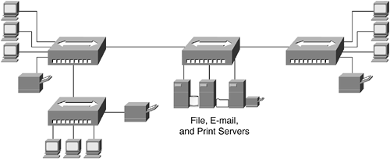
Switched networks
A network that consists of interlinked nodes (machines, network devices) allowing temporary connections between devices
Circuit switching:
  connections given a dedicated path (channel) on the network for transmission
Packet switching:
  connections break up data into IP datagrams
  each connection shares all paths on the network

Slide 6
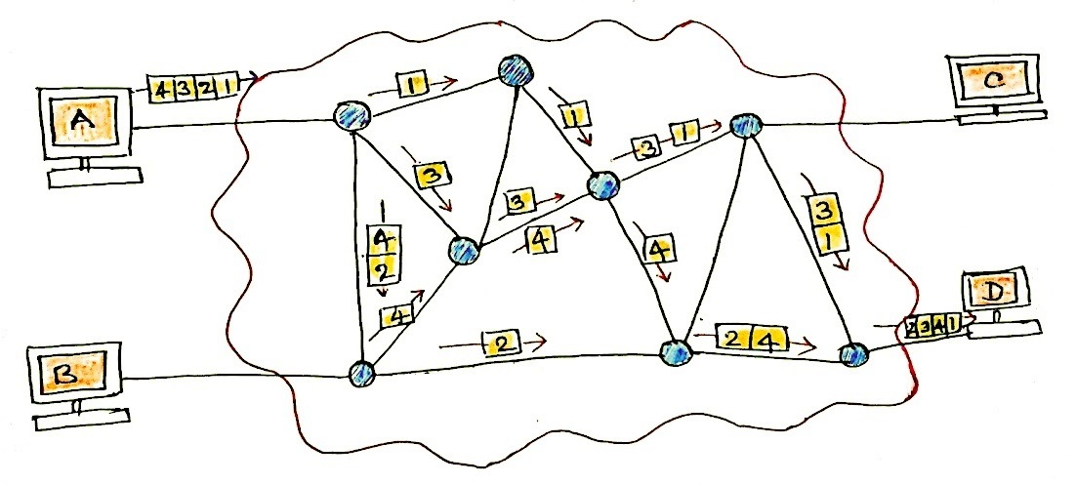
Packet switching

Slide 7
Network models
OSI Model
  “Layered framework for the design of network systems”
  Seven layers
  Each layer is only aware of the layer above/below itself
7 Application
5 Session
6 Presentation
3 Network
2 Data link
1 Physical
4 Transport
HTTP, FTP, SSH
POP/SMTP, FTP, SSH
TCP, UDP
IPv4, IPv6

Slide 8
OSI model
7 Application
5 Session
6 Presentation
3 Network
2 Data link
1 Physical
4 Transport
User Support Layers
Interoperability between software systems
Transport Layer
“Ensures that what lower levels have transmitted, upper levels can use.”
Network Support Layers
1. Physically connections
2. Addressing
3. Reliability

Slide 9
Transmission of packets
7 Application
5 Session
6 Presentation
3 Network
2 Data link
1 Physical
4 Transport
7 Application
5 Session
6 Presentation
3 Network
2 Data link
1 Physical
4 Transport
data formats: clear text,
encrypted text, …
connection, reconnection,
authentication
packetization, error checking
addressing, routing
network frames creation
signal: electrical, optical, radio

Slide 10
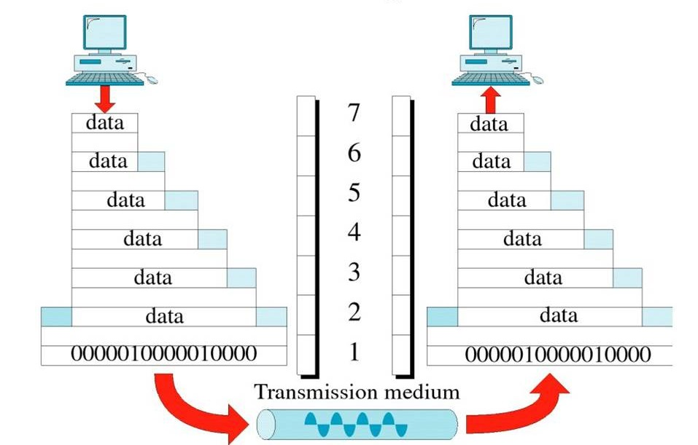
Packet encapsulation

Slide 11

Network addressing
IPv4
  Uses 32 bits and supports ~4,294,967,296 addresses
    Unreliable for the number of modern devices
    Internet of things
  Each address is separated into 4 octets (dotted decimal notation)
    0.0.0.0 → 255.255.255.255
  Examples:
    98.139.180.149
    192.168.0.1
    127.0.0.1 (localhost)

Slide 12
Network addressing
IPv6
  Uses 128 bits and supports up to ~340,282,366,920,938,463,463,374,607,431,768,211,456 addresses
  Each address is separated into 8 segments (hexidecimal notation)
  Examples:
    3FFE:F200:0234:AB00:0123:4567:8901:ABCD
    2001:0DB8:85A3:0000:0000:8A2E:0370:7334
    0:0:0:0:0:0:0:1 (localhost)

Slide 13
Ports
Ports are used to separate traffic from different software programs communicating to/from an IP address
Synonymous with mailboxes
  Imagine mail received inside a large corporation
  Mail is first sent to the address (IP address)
  Mail is then forward to a mailbox (port) for the recipient (program)
Client
Skype traffic
Remote
Machine A
Peer-to-peer traffic
Remote
Machine A
Browser traffic

Slide 14

Ports
Ports are numbered from 1-65535
Ports 1-1023, called well-known ports, are reserved
  HTTP (web traffic): 80
  FTP (file transfer): 21
  SSH (remote login): 22

Slide 15
Well-known ports
Protocol | Well known port | Purpose
echo | 7 | A test protocol that verifies that two machines are able to connect by having on echo back the other’s input.
discard | 9 | Discard is less useful test protocol in which all data received by the server is ignored.
FTP data | 20 | FTP uses two well-known ports. This port is used to transfer files.
FTP | 21 | This port is used to send FTP commands like put and get.
SSH | 22 | Use for encrypted, remote logins.
Telnet | 23 | Use for interactive, remote command-line sessions.
smtp | 25 | The Simple Mail Protocol is used to send email between machines.
time | 37 | A time server returns the seconds elapsed since midnight, Jan. 1, 1900, as a 32bit unsigned integer.
whois | 43 | A simple directory service for Internet network administrators.
finger | 79 | A service that returns information about a user or users on the local system.
HTTP | 80 | The underlying protocol of the World Wide Web.
POP3 | 110 | Post Office Protocol version 3 is a protocol for the transfer of email from the host to clients.
NNTP | 119 | Usenet news transfer; more formally known as the “Network News Transfer Protocol.”
IMAP | 143 | Internet Message Access Protocol is a protocol for accessing mailboxes stored on a server.
HTTPS | 443 | A protocol for using HTTP with Secure Sockets Layer (SSL) and Transport Layer Security (TSL) protocols.
dict | 2628 | A UTF-8 encoded dictionary service that provides definitions of words.
MySQL | 3306 | Port number used for connections to the MySQL DBMS.

Slide 16
Sockets
A socket represents a network connection endpoint.
  Has an IP address
  Has a port
Sockets allow for persistent connections between clients machine and remote servers
Client
Remote
Server
Resource
Data transfer

Slide 17
Client/Server architecture
Network programming

Slide 18
Client/server paradigm
Paradigm: computers are either a client or server
  Server: provide resources in a networked environment
    Processing power, disk drives, access to files
  Client: rely on servers for resources
Name | Resource
File server | Provides access to files
Email server | Stores and forwards emails
HTTP server | Provides access to web documents
Database server | Provides query-able database entities
Print server | Provides access to printer resources

Slide 19
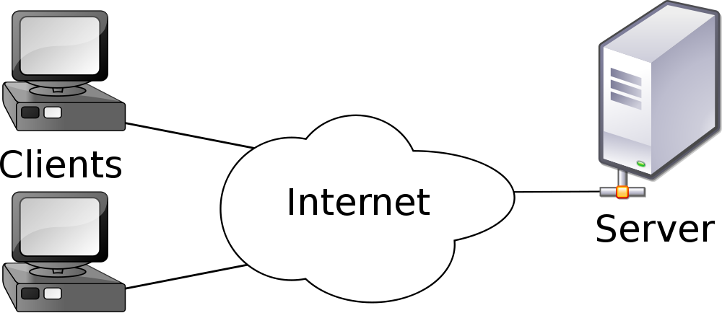
Client/server paradigm
Servers have powerful
hardware to respond to
requests
Clients share access
to server resources

Slide 20
Request-response cycle
A request is made for index.php
While the browser is assembling the page other requests are made
  styles.css
  banner.png
  forms.js
  …
Client
Request
Server
Response
Client
Request
Server
Response
Client
Request
Server
Response
index.php
styles.css
forms.js

Slide 21
Identifying & Accessing resources
URI (uniform resource indicator)
  “a compact sequence of characters that identifies an abstract or physical resource”
  Examples:
    photos.html
    Harry Potter and the Half Blood Prince
    www.bookmarks.com/favorites
URI
URL
URN

Slide 22
Identifying & Accessing resources
URN (uniform resource name)
  “are resource identifiers with the specific requirements for enabling location independent identification of a resource, as well as longevity of reference”
  Examples:
    urn:uuid:bf597844-9efd-11e6-80f5-76304dec7eb7
    urn:isbn:0735619670
    urn:issn:0167-6423
  Represent URI resources with a name
    Names are required to be unique
    Required to follow the urn scheme
URI
URL
URN

Slide 23
Identifying & Accessing resources
URL (uniform resource locator):
  A URI that also indicates how a resource can be found and accessed
  Examples:
    http://www.reddit.com/r/news
    http://www.abcnews.com/news.html
    ftp://mystorage.com/file.txt
URI
URL
URN

Slide 24
URLs vs. URNs
protocol
urn
https://www.cnet.com/laptops/macbookpro.htm
url
location
resource

Slide 25
URLs, URIs and URNs
URI
URL
URN
http://www.cnn.com/index.html
urn:isbn:0735619670
mailto:me@gmail.com

Slide 26
URL format
Format:
  scheme://authority@host:port/path?query#fragment
Schemes: http, https or ftp are common
Authority: a username, password
Host: the domain
Port: the port on the host machine
Path: a logical or virtual path to a resource
Query: a query string for HTTP GET requests
Fragment: an anchor fragment

Slide 27
URL format
Format:
  scheme://authority@host:port/path?query#fragment
Examples:
  http://www.msn.com/news
  https://bob@mysite.com/login.htm
  http://www.surplus.com/viewcart.php?custid=1020&err=0
  ftp://washington.state.gov/viewrules.html#rule3
  http://localhost:8000/test.php?debug=1

Slide 28

Hosting
To provide web resources to clients, you must first host your content on a web server
Content can be stored on __________ and accessed over___________
  Intranet server – local area network
  Web hosting service – World Wide Web
Types of web hosting: shared server, dedicated servers

Slide 29

DNS, domain names
IP addresses are abstracted away from browser users through the use of domain names
Each domain is mapped to one (or more) IP addresses
  Example domains: www.reddit.com, facebook.com, www.greenriver.edu, en.wikipedia.org
  Example IP addresses: 192.168.0.1, 157.166.226.26
DNS servers (registries) maintain tables with these mappings that are available over the internet
  Domain → IP address

Slide 30
Example DNS resolution
A user enters http://www.flowers.com/ landing.php into their browser address bar
The browser makes a DNS request to a known DNS registry over the internet
  The user passes the domain name (www.flowers.com)
  The user receives an ip address for that domain (78.190.22.1)
The browser than completes the users request by requesting http://78.190.22.1/landing.php over HTTP

Slide 31
Example DNS resolution
Client
request
flowers.com
DNS
Registry
response
78.190.22.1
response
landing.php
domain | IP address
flowers.com | 78.190.22.1
amazon.com | 144.52.88.115
suits.mall.com | 179.1.1.0
espn.com | 99.67.1.101
… | …
request
landing.php
Server
(78.190.22.1)

Slide 32
Socket programming
Network programming

Slide 33
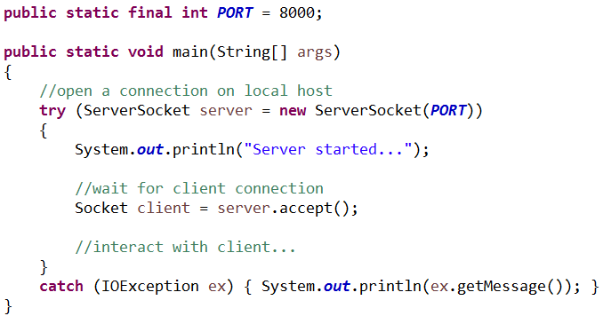
Creating a server socket
Java’s ServerSocket class enables a client program to connect to a machine through a given port
Blocks until a
client makes a
connection

Slide 34
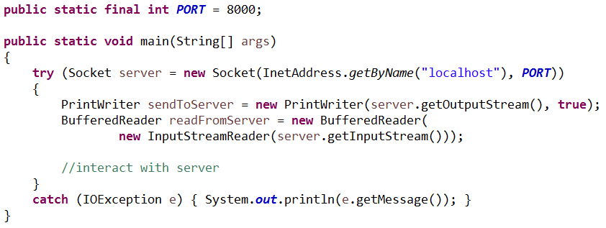
Creating a client socket
Java’s Socket class creates a connection from
  server → client
  client → server
Causes
ServerSocket.accept()
to unblock

Slide 35
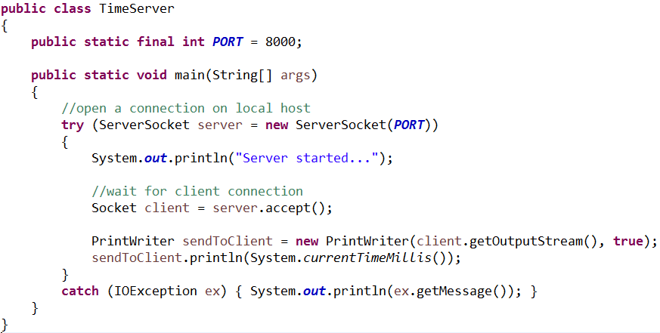
Time server
Time protocol: “provides a site-independent, machine readable date and time”

Slide 36
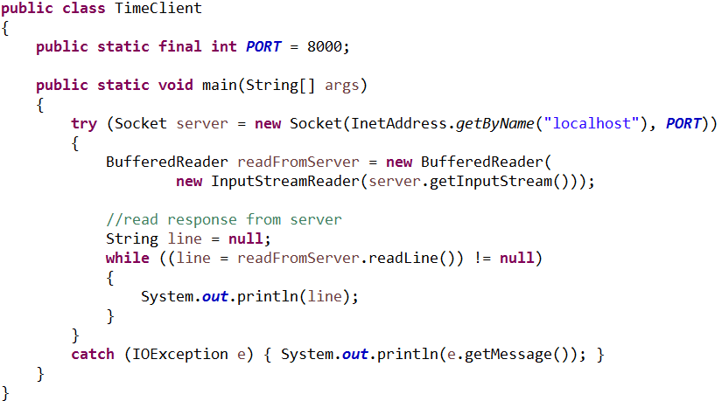
Time server
Time protocol: “provides a site-independent, machine readable date and time”

Slide 37
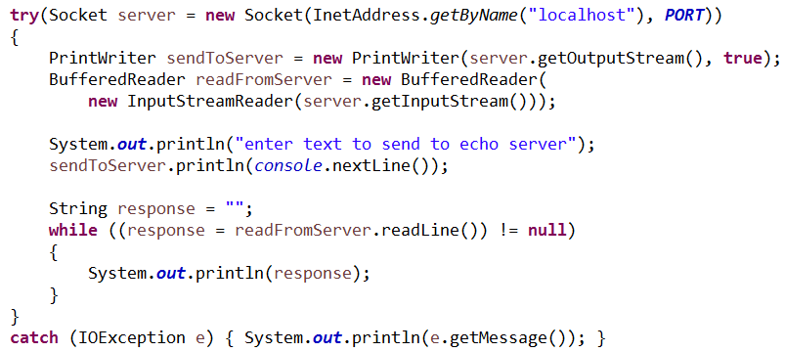
Echo server
Echo protocol: “A very useful debugging and measurement tool is an echo service. An echo service simply sends back to the originating source any data it receives.”
EchoClient

Slide 38
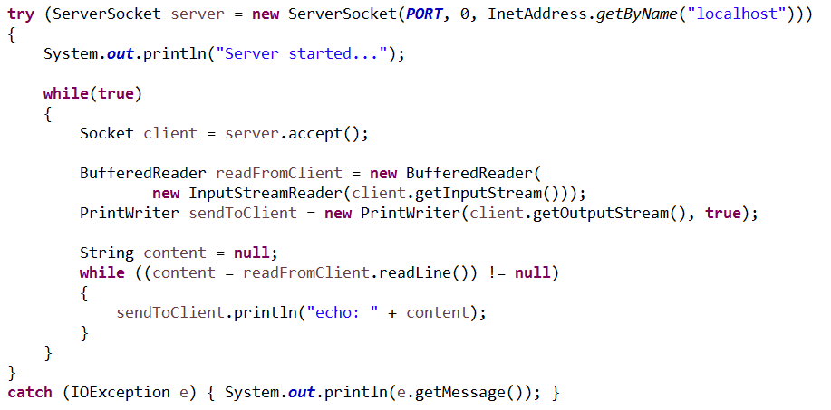
Echo server
Echo protocol: “A very useful debugging and measurement tool is an echo service. An echo service simply sends back to the originating source any data it receives.”
EchoServer

Slide 39
Try it!
Create a server that responds to a new math protocol
A server that uses the math protocol should respond to requests in the following way
  Given “a b”, where a & b are integers
    Responds with the addition, subtraction, multiplication, division and modulus of a & b
  Given any other input
    Responds with “Math protocol expects: <num1> <num2>”
Test your server with a client socket connection
> 10 2
10 + 2 = 12
10 – 2 = 8
10 * 2 = 20
10 / 2 = 5
10 % 2 = 0
>
> asdf
Math protocol expects: <num1> <num2>
> 10
Math protocol expects: <num1> <num2>
>

Slide 40

Server socket design challenges
Client sockets should be pushed to secondary threads
  This avoids blocking on the server
  The server stays responsive to client connection requests
What could go wrong?
  Using too much memory for client threads
Try reusable threads with a thread pool
  Thread pools manage a group of threads
  A program can request a thread
  A terminated thread is returned to the pool
  A programmer can specify the size of the pool

Slide 41
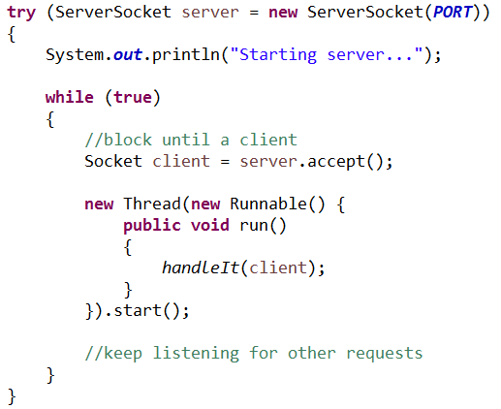

Client socket threads

Slide 42
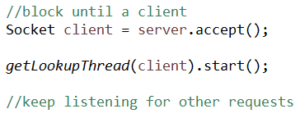

Dictionary server
Dictionary protocol: “The Dictionary Server Protocol (DICT) is a TCP transaction based query/response protocol that allows a client to access dictionary definitions from a set of natural language dictionary databases.”
Dictionary Server

Slide 43
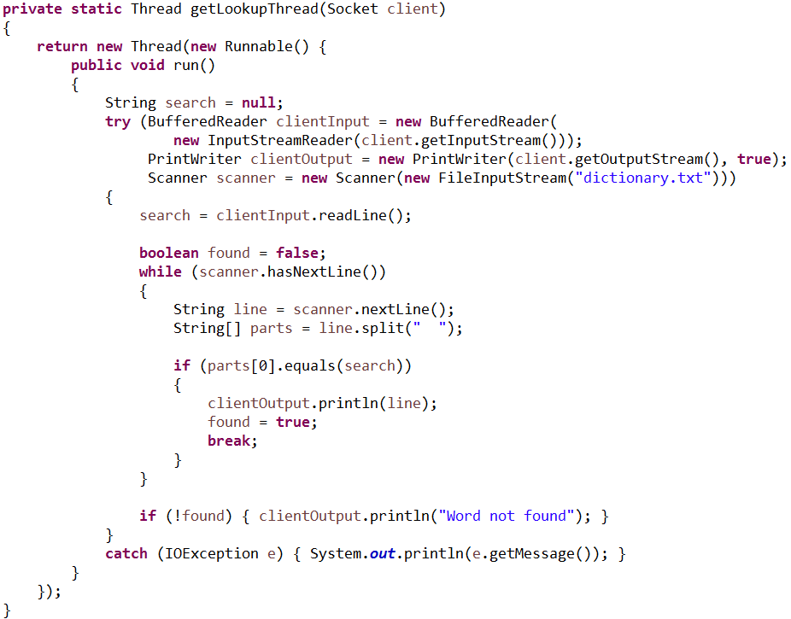
Dictionary Server

Slide 44
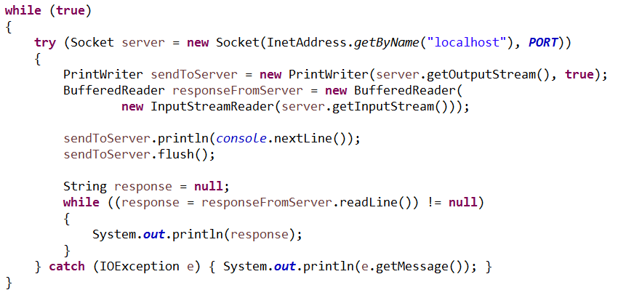
Dictionary Server
Dictionary Client

Slide 45
HTTP
Network programming

Slide 46
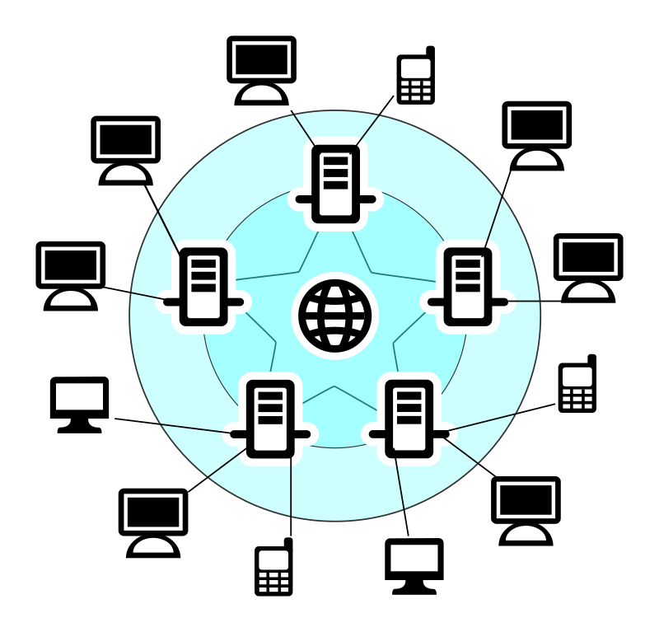
HTTP the protocol
HTTP (hypertext transfer protocol): “is an application-level protocol for distributed, collaborative, hypermedia information systems. It is a generic, stateless, protocol which can be used for many tasks beyond its use for hypertext”

Slide 47
HTTP methods
HTTP methods describe the possible interactions between client and server using HTTP
Method | Description
GET | Requests data from a specified resource
POST | Submits data to be processed to a specified resource
PUT | Uploads a representation of the specified URI
DELETE | Deletes the specified resource
HEAD | Same as GET but returns only HTTP headers and no document body
OPTIONS | Returns the HTTP methods that the server supports
CONNECT | Converts the request connection to a transparent TCP/IP tunnel

Slide 48
HTTP request header
Request line
  Method
  URI
  HTTP version
Host: requested host
Cache-control: controls page
caching
User-agent: user’s browser, OS
Accept: acceptable MIME types
Accept-*: acceptable encoding, language
Cookies: files sent to server to control client state
GET http://www.cnn.com/ HTTP/1.1
Host: www.cnn.com
Proxy-Connection: keep-alive
Cache-Control: max-age=0
Upgrade-Insecure-Requests: 1
User-Agent: Mozilla/5.0 (Windows NT 6.1 …
Accept: text/html,application/xhtml+xml …
Accept-Encoding: gzip, deflate, sdch
Accept-Language: en-US,en;q=0.8
Cookie: …

Slide 49
HTTP response header
Status line
  HTTP version
  Status code
  Reason phrase
HTTP/1.1 200 OK
Via: 1.1 varnish, 1.1 PYRAMID-E
Connection: Keep-Alive
Proxy-Connection: Keep-Alive
Content-Length: 149456
Age: 275
Date: Mon, 31 Oct 2016 20:39:15 GMT
Content-Type: text/html; charset=utf-8
…
Cache-Control: max-age=60
…
Set-Cookie: countryCode=US; …
Set-Cookie: geoData=Auburn|WA…
…

Slide 50
Status codes
1xx: Informational - Request received, continuing process
2xx: Success - The action was successfully received, understood, and accepted
3xx: Redirection - Further action must be taken in order to complete the request
4xx: Client Error - The request contains bad syntax or cannot be fulfilled
5xx: Server Error - The server failed to fulfill an apparently valid request
HTTP/1.1 200 OK
Via: 1.1 varnish, 1.1 PYRAMID-E
Connection: Keep-Alive
Proxy-Connection: Keep-Alive
Content-Length: 149456
Age: 275
Date: Mon, 31 Oct 2016 20:39:15 GMT
Content-Type: text/html; charset=utf-8
…
Cache-Control: max-age=60
…
Set-Cookie: countryCode=US; …
Set-Cookie: geoData=Auburn|WA…
…

Slide 51
Status codes
Common codes | Reason phrase
200 | OK
301 | Moved permanently
401 | Not authorized
403 | Forbidden
404 | Not found
500 | Internal server error
503 | Service unavailable
504 | Gateway timeout
HTTP/1.1 200 OK
Via: 1.1 varnish, 1.1 PYRAMID-E
Connection: Keep-Alive
Proxy-Connection: Keep-Alive
Content-Length: 149456
Age: 275
Date: Mon, 31 Oct 2016 20:39:15 GMT
Content-Type: text/html; charset=utf-8
…
Cache-Control: max-age=60
…
Set-Cookie: countryCode=US; …
Set-Cookie: geoData=Auburn|WA…
…

Slide 52
HTTP response header
Connection: is this a persistent
connection?
Content-length: document
size in bytes
Age: document age
Date: server time
Content-type: MIME type
for response
Cache-control: controls page caching
Set-Cookie: save cookie to server to control client state
HTTP/1.1 200 OK
Via: 1.1 varnish, 1.1 PYRAMID-E
Connection: Keep-Alive
Proxy-Connection: Keep-Alive
Content-Length: 149456
Age: 275
Date: Mon, 31 Oct 2016 20:39:15 GMT
Content-Type: text/html; charset=utf-8
…
Cache-Control: max-age=60
…
Set-Cookie: countryCode=US; …
Set-Cookie: geoData=Auburn|WA…
…

Slide 53
Web servers
GET http://www.cnn.com/ HTTP/1.1
Host: www.cnn.com
Proxy-Connection: keep-alive
Cache-Control: max-age=0
Remote Server (Linux)
HTTP Server (Apache
Request
File
Client
HTTP Request (index.php)
Send
File
HTTP Response
Access
File
Execute
PHP Script
File
System
PHP
Engine
HTTP/1.1 200 OK
Via: 1.1 varnish, 1.1 PYRAMID-E
…
<!doctype html><html>…

Slide 54
HTTP programming
Network programming

Slide 55
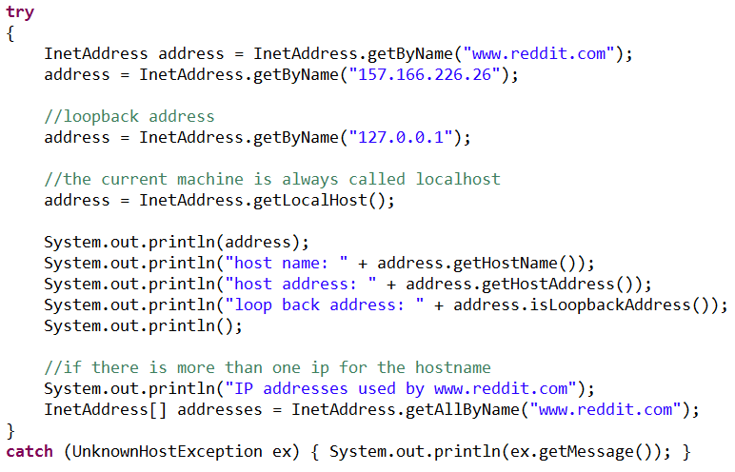
HTTP connections
IP addresses can be represented using the InetAddress class

Slide 56
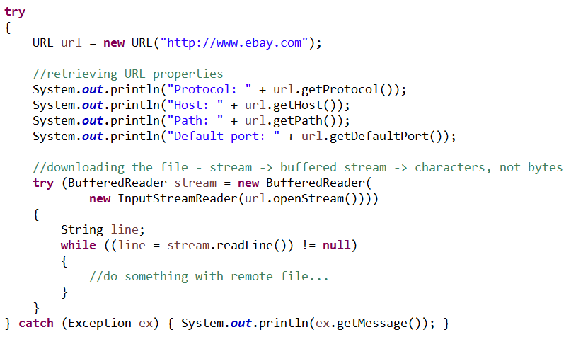
HTTP connections
URLs are represented using the URL class

Slide 57
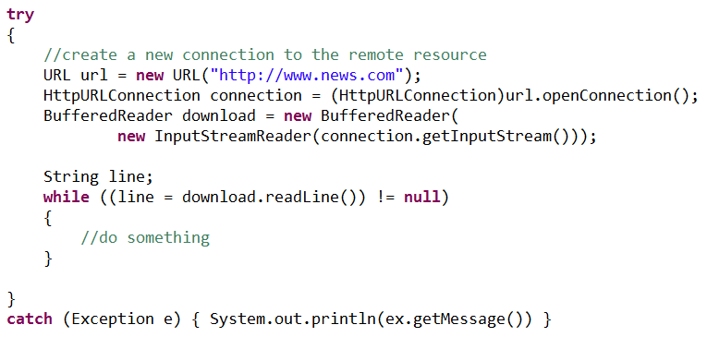
HTTP connections
Connections through HTTP are managed through an HTTPUrlConnection class

Slide 58
Miscellaneous
Network programming

Slide 59
Base64 encoding and HTTP
Base64 is a binary-to-text encoding scheme used to send non-text data over text-only protocols (HTTP)
Technique:
  View non-text data as a stream of bits
  Convert every 6 bits into one of the following 64 characters:
    ABCDEFGHIJKLMNOPQRSTUVWXYZabcdefghijklmnopqrstuvwxyz0123456789+/
    Each possible string of 6 bits is mapped to character
      0 = A
      1 = B
      2 = C
      …
      62 = 9
      63 = +
      64 = /
encoding: qZIV
binary data: 101111011001001000100101

Slide 60
Base64 encoding and HTTP
Technique:
  Send characters over HTTP
  Receive characters at destination
  Convert back to groups of 6 bits
101111011001001000100101
encode
How can we determine
the type of content
at our destination?
qZIV
decode
101111011001001000100101

Slide 61
Mime types
Extension | MIME type
.bmp | image/bmp
.css | text/css
.dtd | application/xml-dtd
.doc | application/msword
.exe | application/octet-stream
.gif | image/gif
.html | text/html
.jar | application/java-archive
.jpg | image/jpeg
.js | application/x-javascript
.mp3 | audio/mpeg
.mpeg | video/mpeg
.pdf | application/pdf
.png | image/png
.ppt | application/vnd.ms-powerpoint
.rtf | application/rtf
.svg | image/svg+xml
.swf | application/x-shockwave-flash
.tiff | image/tiff
.txt | text/plain
.wav | audio/wav, audio/x-wav
.xls | application/vnd.ms-excel
.xml | application/xml
.zip | application/zip, application/x-compressed-zip
Multipurpose Internet Mail Extensions
Identifiers for file types sent across the WWW
  HTML document: text/html
  CSS document: text/css
  JavaScript document: application/x-javascript
Historically used while passing binary data over mail (text-only) protocols
HTTP uses MIME types to identify file formats/contents

Slide 62
Sources
Berners-Lee, Tim, Roy Fielding and Larry Masinter. RFC 3986 - Uniform Resource Identifier (URI): Generic Syntax. 1 Sep. 2016. <https://tools.ietf.org/html/rfc3986>.
Time Protocol. 1 Sep. 2016. <https://tools.ietf.org/html/rfc868>.
Echo Protocol. 1 Sep. 2016. <https://tools.ietf.org/html/rfc862>.
Faith, Rickard, Bret Martin. A Dictionary Server Protocol. 1 Sep. 2016.
<https://tools.ietf.org/html/rfc2229>.

Slide 63
Concurrent Programming
IT 301

